Slide 1


Chapter 4: Kubernetes API Overview and resources
Agile Brains Consulting
1
©Agile Brains Consulting Inc. All rights reserved. Not to be reproduced without prior written consent.

Slide 2
Pods
Agile Brains Consulting
2
©Agile Brains Consulting Inc. All rights reserved. Not to be reproduced without prior written consent.

Slide 3
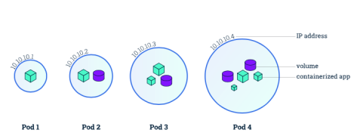
Kubernetes: Pods
The smallest unit that can be scheduled to be deployed through K8s is called a pod.
Homogeneous group of containers.
This group of containers would share storage, Linux namespaces, cgroups, IP addresses. These are co-located, hence share resources and are always scheduled together.
Pods are not intended to live long. They are created, destroyed and re-created on demand, based on the state of the server and the service itself.
Containers in a pod share
IP address and port space
Filesystem
Storage (Volumnes)
Labels
Secrets
Agile Brains Consulting
3
©Agile Brains Consulting Inc. All rights reserved. Not to be reproduced without prior written consent.
Notes:
Additionally, pods can be tagged with a label for recommended scheduling advice

Slide 4
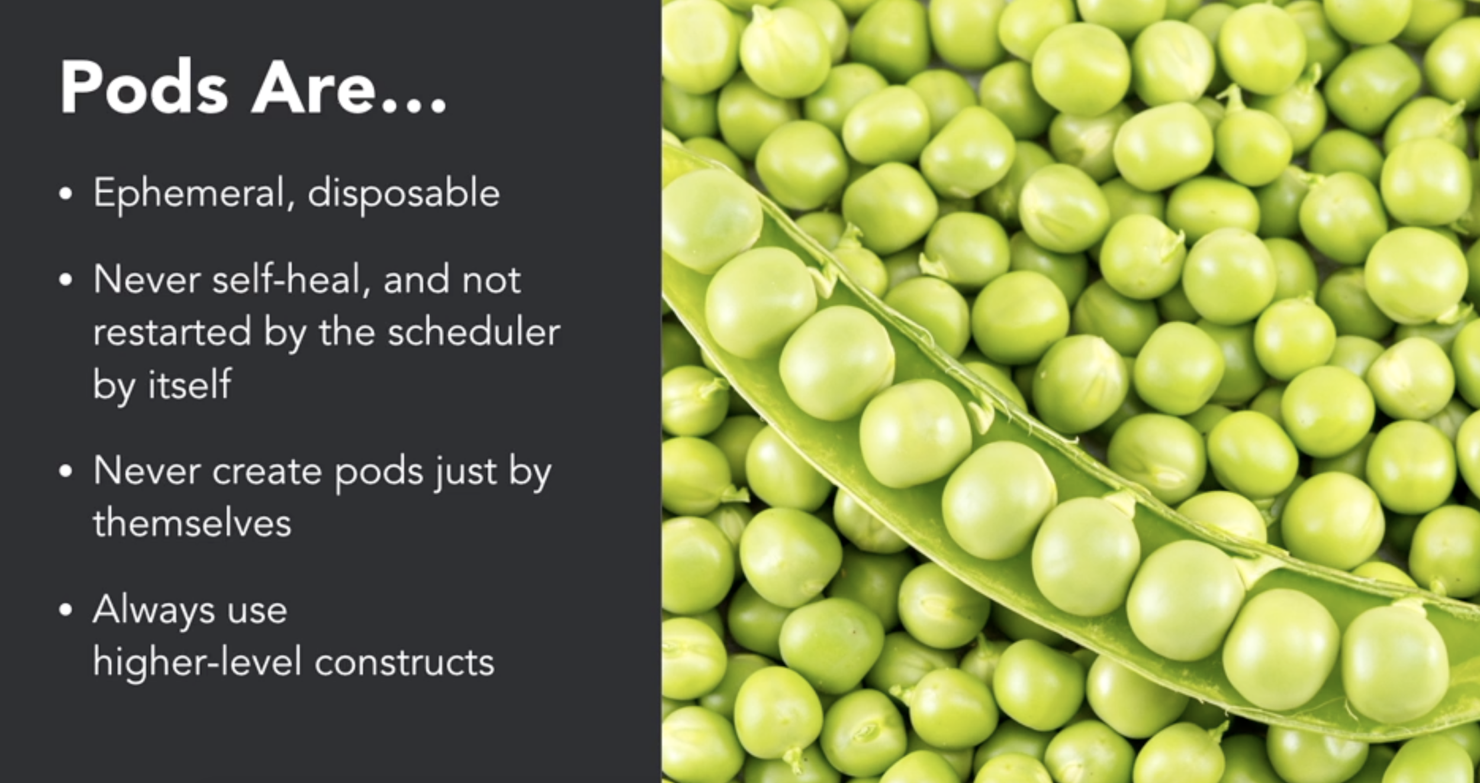
Kubernetes: Pods
Ref:- https://www.linkedin.com/learning/learning-kubernetes/next-steps
Agile Brains Consulting
4
©Agile Brains Consulting Inc. All rights reserved. Not to be reproduced without prior written consent.
Notes:
Additionally, pods can be tagged with a label for recommended scheduling advice

Slide 5
Kubernetes: Pod States
Pending (request accepted, one or more containers are still being created)
Running (Pod has been bound to a node, all of the Containers have been created. At least one Container is still running, or is in the process of starting or restarting.)
Succeeded (All Containers in the Pod have terminated in success, and will not be restarted)
Failed (All Containers in the Pod have terminated, and at least one container has terminated with some failure)
CrashLoopBackOff (pod starting, crashing, starting again, and then crashing again.)
Agile Brains Consulting
5
©Agile Brains Consulting Inc. All rights reserved. Not to be reproduced without prior written consent.
Notes:
Additionally, pods can be tagged with a label for recommended scheduling advice

Slide 6
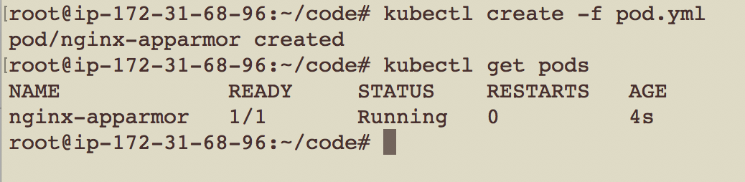
pod.yml
apiVersion: v1
kind: Pod
metadata:
name: nginx-apparmor
labels:
app: nginx
spec:
containers:
- name: nginx
image: nginx
ports:
- containerPort: 80
Note: This is just creation of the pod. In order to expose it, a service must be created. In order for it to get restarted, a deployment or replication control must be created.
Agile Brains Consulting
6
©Agile Brains Consulting Inc. All rights reserved. Not to be reproduced without prior written consent.
Notes:
Create a simple pod.yaml with the following contents
apiVersion: v1
kind: Pod
metadata:
name: nginx
labels:
name: nginx
spec:
containers:
- name: nginx
image: nginx
ports:
- containerPort: 80
2. Kubectl create –f pod.yaml
3. Kubectl get pods
This highlights an example of Kubernetes deployment creation. As with many Kubernetes objects, deployments are usually created from a file such as a yaml or json. While this could be done via command line it is often impractical to do so.
Further reading:
https://kubernetes.io/docs/concepts/workloads/controllers/deployment/#creating-a-deployment

Slide 7
Controllers
Agile Brains Consulting
7
©Agile Brains Consulting Inc. All rights reserved. Not to be reproduced without prior written consent.

Slide 8
Controllers
Kubernetes contains a number of higher-level abstractions called Controllers. Controllers build upon the basic objects, and provide additional functionality and convenience features.
They are
ReplicationController
ReplicaSet
Deployment
StatefulSet
DaemonSet
Job
Agile Brains Consulting
8
©Agile Brains Consulting Inc. All rights reserved. Not to be reproduced without prior written consent.

Slide 9
Replication Controller
The original form of replication in Kubernetes. Its now preferred to use Replicate Sets via a Deployment
Ensures that a specified number of pod replicas are running at any one time. If a pod does crash, the Replication Controller replaces it.
Allows you to scale the number of pods, and to update or delete multiple pods with a single command.
Agile Brains Consulting
9
©Agile Brains Consulting Inc. All rights reserved. Not to be reproduced without prior written consent.

Slide 10
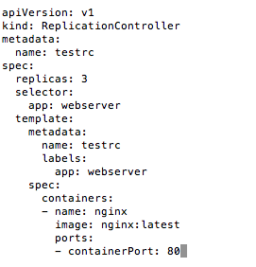
Replication Controller
This file says:
We need to have 3 replicas of this Pod
The Pod has 1 container (image: nginx)
Create the Replication controller:
kubectl create -f rc.yaml
Agile Brains Consulting
10
©Agile Brains Consulting Inc. All rights reserved. Not to be reproduced without prior written consent.

Slide 11
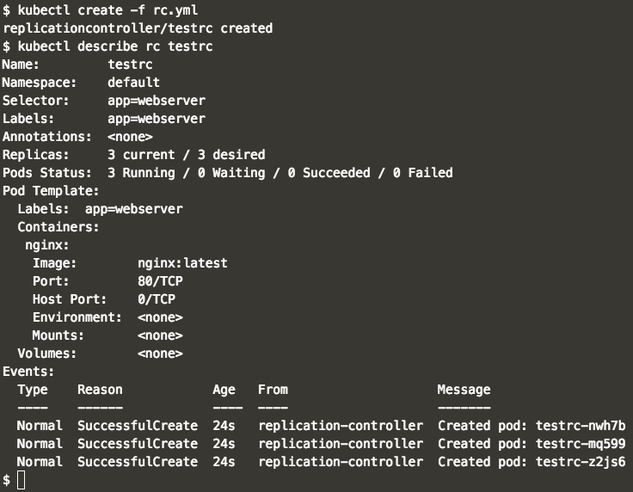
Replication Controller
Agile Brains Consulting
11
©Agile Brains Consulting Inc. All rights reserved. Not to be reproduced without prior written consent.

Slide 12
Replica-set
Agile Brains Consulting
12
©Agile Brains Consulting Inc. All rights reserved. Not to be reproduced without prior written consent.

Slide 13
Replica Set
It is essentially the same as Replication Controller except that it has more options for selector:
matchLabels
matchExpressions
Agile Brains Consulting
13
©Agile Brains Consulting Inc. All rights reserved. Not to be reproduced without prior written consent.

Slide 14
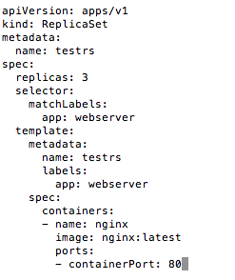
Replica Set
This Replica Set has the same rules as the Replication Controller in the previous slide.
This file says:
We need to have 3 replicas of this Pod
The Pod has 1 container (image: nginx)
Create the Replication controller:
kubectl create -f rs.yaml
Agile Brains Consulting
14
©Agile Brains Consulting Inc. All rights reserved. Not to be reproduced without prior written consent.

Slide 15
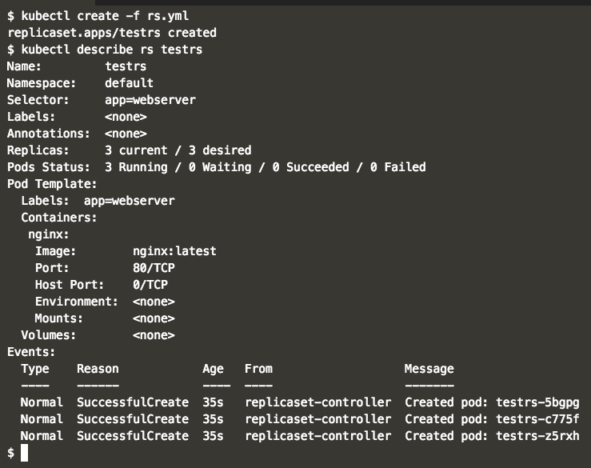
Replica Set
Agile Brains Consulting
15
©Agile Brains Consulting Inc. All rights reserved. Not to be reproduced without prior written consent.

Slide 16
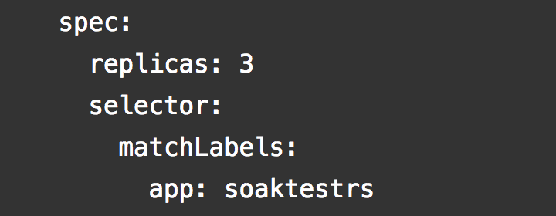
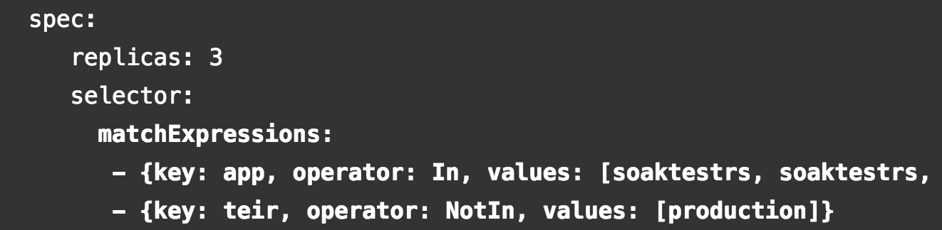
Replica Set – match labels and expressions
Agile Brains Consulting
16
©Agile Brains Consulting Inc. All rights reserved. Not to be reproduced without prior written consent.

Slide 17
Deployments
Agile Brains Consulting
17
©Agile Brains Consulting Inc. All rights reserved. Not to be reproduced without prior written consent.

Slide 18
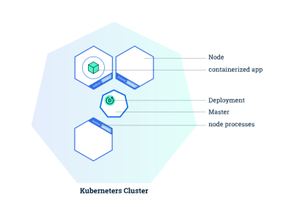
Kubernetes: Deployments
Allows you to deploy a (self-healing) instance of an application.
Self Healing: Continuously monitors and replaces instances if necessary
Provides declarative updates for Pods and Replica Sets
Updates actual state to desired state at a controlled rate
For example: Current state is 3 instances of Tomcat. Desired state is 5 instances of Tomcat -> Create 2 more instances of Tomcat
Agile Brains Consulting
18
©Agile Brains Consulting Inc. All rights reserved. Not to be reproduced without prior written consent.
Notes:
Deployments (and controllers) are loops that maintain state.

Slide 19
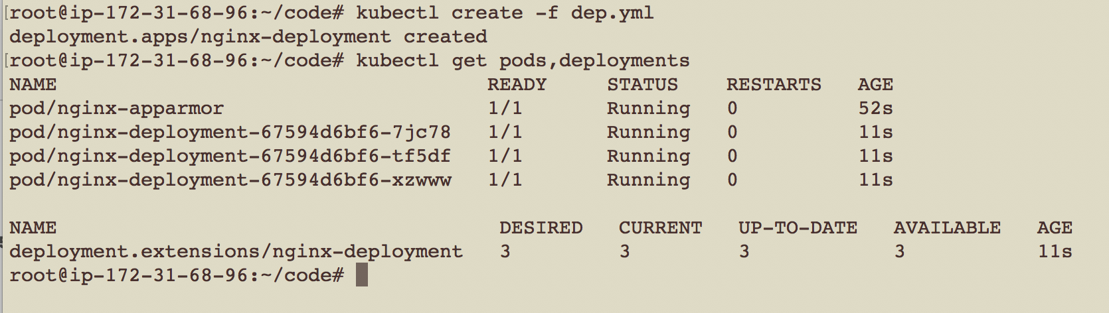
dep.yml
apiVersion: apps/v1
kind: Deployment
metadata:
name: nginx-deployment
labels:
app: nginx
spec:
replicas: 3
selector:
matchLabels:
app: nginx
template:
metadata:
labels:
app: nginx
spec:
containers:
- name: nginx
image: nginx:1.7.9
ports:
- containerPort: 80
Agile Brains Consulting
19
©Agile Brains Consulting Inc. All rights reserved. Not to be reproduced without prior written consent.

Slide 20
Kubectl create/apply
kubectl create -f <yaml_file>
kubectl create -f <yaml_file_1> -f <yaml_file_2>
kubectl create -f <json_file>
kubectl create -f <url_name>
kubectl create -f <directory_name>
kubectl create tell the Kubernetes API what you want to create, replace or delete. It’s a imperative approach and good if single person is working in the team.
kubectl apply – apply changes to a live object. It’s a declarative approach and good when you want to maintain versions
Ref:- https://www.linkedin.com/learning/learning-kubernetes/next-steps
Agile Brains Consulting
20
©Agile Brains Consulting Inc. All rights reserved. Not to be reproduced without prior written consent.
Notes:
Create a pod.yaml with the following contents
apiVersion: v1
kind: Pod
metadata:
name: nginx
labels:
name: nginx
spec:
containers:
- name: nginx
image: nginx
ports:
- containerPort: 80
2. Kubectl create –f pod.yaml
3. Kubectl get pods
This highlights an example of Kubernetes deployment creation. As with many Kubernetes objects, deployments are usually created from a file such as a yaml or json. While this could be done via command line it is often impractical to do so.
Further reading:
https://kubernetes.io/docs/concepts/workloads/controllers/deployment/#creating-a-deployment
Note: This is a simple pod. This is interesting.

Slide 21
Lab (rc, rs, deploy)
Exercise to create Replication Controllers, Replica Sets and Deployments and describe their functions
Check the results and describe the objects
sudo su -
git clone https://github.com/shekhar2010us/kubernetes_teach_git.git
cd kubernetes_teach_git/ex1/
https://github.com/shekhar2010us/kubernetes_teach_git/blob/master/ex1/rc_rs_deployment.md
Agile Brains Consulting
21
©Agile Brains Consulting Inc. All rights reserved. Not to be reproduced without prior written consent.

Slide 22
Services
Agile Brains Consulting
22
©Agile Brains Consulting Inc. All rights reserved. Not to be reproduced without prior written consent.

Slide 23
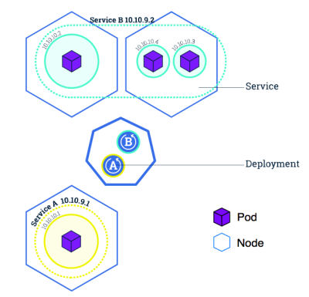
Kubernetes: Service
Abstraction regarding a set of pods which enables load balancing, traffic exposure, load balancing and service discovery.
pods to die and replicate in Kubernetes without affecting your application.
Enable loose coupling between different Pods.
Provides a stable virtual IP and port
Services allow Pods to receive traffic.
Each Pod has a unique IP but those IP addresses are not exposed outside the Pod without a service.
Agile Brains Consulting
23
©Agile Brains Consulting Inc. All rights reserved. Not to be reproduced without prior written consent.

Slide 24
Kubernetes: Types of Services
Cluster IP: Expose the service on a cluster-internal IP. Using this makes the service only reachable from within the cluster (no external access).
NodePort: Expose the service on each Node’s IP at a static port. One service per port, only use ports 30000–32767, have to deal with port changes
Load Balancer: Expose the service externally using load balancer. The Kubernetes service controller automates the creation of the external load balancer, health checks (if needed), firewall rules (if needed) and retrieves the external IP allocated by the cloud provider and populates it in the service object
Agile Brains Consulting
24
©Agile Brains Consulting Inc. All rights reserved. Not to be reproduced without prior written consent.
Notes:
When the service type is set to LoadBalancer, Kubernetes provides functionality equivalent to type=<ClusterIP> to pods within the cluster and extends it by programming the (external to Kubernetes) load balancer with entries for the Kubernetes pods. The Kubernetes service controller automates the creation of the external load balancer, health checks (if needed), firewall rules (if needed) and retrieves the external IP allocated by the cloud provider and populates it in the service object.
https://medium.com/google-cloud/kubernetes-nodeport-vs-loadbalancer-vs-ingress-when-should-i-use-what-922f010849e0 and https://medium.com/google-cloud/kubernetes-from-load-balancer-to-pod-3f2399637b0c

Slide 25
root@ip-172-31-68-96:~# kubectl get svc
NAME TYPE CLUSTER-IP EXTERNAL-IP PORT(S) AGE
kubernetes ClusterIP 10.96.0.1 <none> 443/TCP 37m
root@ip-172-31-68-96:~#
root@ip-172-31-68-96:~# kubectl expose deployment nginx-deployment --type=LoadBalancer --name=nginx-service
service/nginx-service exposed
root@ip-172-31-68-96:~#
root@ip-172-31-68-96:~# kubectl get svc
NAME TYPE CLUSTER-IP EXTERNAL-IP PORT(S) AGE
kubernetes ClusterIP 10.96.0.1 <none> 443/TCP 37m
nginx-service LoadBalancer 10.102.89.83 <pending> 80:31095/TCP 3s
root@ip-172-31-68-96:~#
Agile Brains Consulting
25
©Agile Brains Consulting Inc. All rights reserved. Not to be reproduced without prior written consent.
Notes:
-- to make NodePort work - https://stackoverflow.com/questions/45543694/kubernetes-cluster-on-aws-with-kops-nodeport-service-unavailable/45561848#45561848 , show this in a 2 cluster node, using nodeport and exposing , only the inbound rule for that node - http://34.222.12.167:32083/
kubectl expose pod sharevol --type NodePort --name sharevol-service --port 3006
Example - create node , expose as nodePort service
kubectl expose pod nginx-apparmor --type NodePort --name nginx-apparmor-service --port 3003
-- to make NodePort work - https://stackoverflow.com/questions/45543694/kubernetes-cluster-on-aws-with-kops-nodeport-service-unavailable/45561848#45561848 , show this in a 2 cluster node, using nodeport and exposing , only the inbound rule for that node - http://34.222.12.167:32083/

Slide 26
Kubectl Create Services – using CLI
-- Create directly a deployment from CLI without the config file (Object management using Imperative Commands - e.g. run , expose, autoscale)
$ kubectl run nginx-deployment --image nginx --port 80
$ kubectl get nodes
$ kubectl get po, deploy, rs
-- exposing the deployment as a service LoadBalancer type and access the Nginx
$ kubectl expose deploy/nginx-deployment --type=LoadBalancer --name nginx-service
$ kubectl get all (command shows all)
$ kubectl get deploy/hw -o yaml (returns the yaml that creates the deployment)
-- then you can describe the service and do a curl , on port 80 with internal IP or external IP and the exposed port outside
$ kubectl expose pod pod_name --type NodePort --name pod_name-service --port 30006
Agile Brains Consulting
26
©Agile Brains Consulting Inc. All rights reserved. Not to be reproduced without prior written consent.
Notes:
kubectl get services --all-namespaces
This reveals the kubernetes services that are usually running as part of the kubernetes system namespace.
http://kubernetesbyexample.com/services/
As mentioned previously, a Service is backed by a group of Pods. These Pods are exposed through endpoints. The Service’s selector will be evaluated continuously and the results will be POSTed to an Endpoints object also named my-nginx. When a Pod dies, it is automatically removed from the endpoints, and new Pods matching the Service’s selector will automatically get added to the endpoints. Check the endpoints, and note that the IPs are the same as the Pods created in the first step:

Slide 27
Kubectl Create Services – using Config
-- Create a deployment with the config file (Object management using Imperative configuration files)
$ kubectl create -f red.yaml
$ kubectl get po, deploy, rs
-- Create Kubernetes Object using Declarative management of objects (The kubectl apply command calculates the patch request using the configuration file, the live configuration, and the last-applied-configuration annotation stored in the live configuration)
$ kubectl apply -f <file_name>
$ kubectl get po, deploy, rs
edit the file , and try the apply again
$ kubectl apply -f <file_name>
$ kubectl get po, deploy, rs
Agile Brains Consulting
27
©Agile Brains Consulting Inc. All rights reserved. Not to be reproduced without prior written consent.
Notes:
The kubectl apply command calculates this patch request using the configuration file, the live configuration, and the last-applied-configuration annotation stored in the live configuration
The kubectl apply command writes the contents of the configuration file to the kubectl.kubernetes.io/last-applied-configuration annotation. This is used to identify fields that have been removed from the configuration file and need to be cleared from the live configuration. Here are the steps used to calculate which fields should be deleted or set:
Calculate the fields to delete. These are the fields present in last-applied-configuration and missing from the configuration file.
Calculate the fields to add or set. These are the fields present in the configuration file whose values don’t match the live configuration.
Here’s an example. Suppose this is the configuration file for a Deployment object:

Slide 28
Lab (Pods, Deploy, Services)
For all the concepts discussed until now
Create pods, Services, Deployments
Various ways to use the create command
We already have the git repo cloned in our machines.
$$ cd to the ex2
https://github.com/shekhar2010us/kubernetes_teach_git/blob/master/ex2/pod_deploy_service.md
Agile Brains Consulting
28
©Agile Brains Consulting Inc. All rights reserved. Not to be reproduced without prior written consent.
Notes:
kubectl get services --all-namespaces
This reveals the kubernetes services that are usually running as part of the kubernetes system namespace.
http://kubernetesbyexample.com/services/
As mentioned previously, a Service is backed by a group of Pods. These Pods are exposed through endpoints. The Service’s selector will be evaluated continuously and the results will be POSTed to an Endpoints object also named my-nginx. When a Pod dies, it is automatically removed from the endpoints, and new Pods matching the Service’s selector will automatically get added to the endpoints. Check the endpoints, and note that the IPs are the same as the Pods created in the first step:

Slide 29
Kubernetes Popular commands
Popular commands
kubectl get - list resources about a target.
kubectl get services, kubectl get pods
kubectl describe - show basic information about a resource
Kubectl describe pods my-pod
kubectl logs - print the logs from a container in a pod. Extremely useful
Kubectl logs my-pod
Also useful:
kubectl exec - execute a command on a container in a pod
Kubectl top – Show metrics for a node (needs Heapster)
Agile Brains Consulting
29
©Agile Brains Consulting Inc. All rights reserved. Not to be reproduced without prior written consent.
Notes:
Trivia: Some internal Kubernetes engineers pronounce kubectl as ‘kubecuttle’
kubectl apply vs kubectl replace, create , vs using config files - https://medium.com/bitnami-perspectives/imperative-declarative-and-a-few-kubectl-tricks-9d6deabdde
Objects using Imperative commands, objects using imperative config files, and declarative commands

Slide 30
Storage
Agile Brains Consulting
30
©Agile Brains Consulting Inc. All rights reserved. Not to be reproduced without prior written consent.

Slide 31
Kubernetes: Volumes
On-disk files in a container are the simplest place for an application to write data, but this approach has drawbacks. The files are lost when the container crashes or stops for any other reason. Furthermore, files within a container are inaccessible to other containers running in the same Pod. The Kubernetes Volume abstraction addresses both of these issues.
A directory accessible to all containers in a pod
Volumes out live containers that run within a pod
May be passed between pods
Data is preserved across container restarts
Agile Brains Consulting
31
©Agile Brains Consulting Inc. All rights reserved. Not to be reproduced without prior written consent.

Slide 32
Kubernetes: Persistent Volume
Persistent storage in a cluster
Separate from PersistentVolumeClaim, which is a request for storage.
May be created ahead of time in a static manner for use by a cluster
May be created dynamically from available, unclaimed resources
May be freed and passed from user to user so care should be taken to delete contents when done with use
Critical for Stateful containers
Agile Brains Consulting
32
©Agile Brains Consulting Inc. All rights reserved. Not to be reproduced without prior written consent.

Slide 33
Kubernetes: Persistent Volumes
PV: Storage in the cluster that has been provisioned by an administrator (static or dynamic) and is independent of any individual pod that uses the PV.
Following volumes are supported by Kubernetes:
GCEPersistentDisk ; AWSElasticBlockStore
AzureFile ; AzureDisk
FC (Fibre Channel) ; FlexVolume
Flocker ; NFS
iSCSI ; RBD (Ceph Block Device)
CephFS ; Cinder (OpenStack block storage)
Glusterfs ; VsphereVolume
Portworx Volumes ; ScaleIO Volumes
StorageOS
Agile Brains Consulting
33
©Agile Brains Consulting Inc. All rights reserved. Not to be reproduced without prior written consent.

Slide 34
Example: Persistent Volumes
apiVersion: v1
kind: PersistentVolume
metadata:
name: pv0003
spec:
capacity:
storage: 5Gi
volumeMode: Filesystem
accessModes:
- ReadWriteOnce
persistentVolumeReclaimPolicy: Recycle
storageClassName: slow
mountOptions:
- hard
- nfsvers=4.1
nfs:
path: /tmp
server: 172.17.0.2
Agile Brains Consulting
34
©Agile Brains Consulting Inc. All rights reserved. Not to be reproduced without prior written consent.

Slide 35
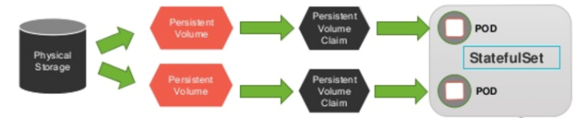
Kubernetes: Persistent Volume Claims
PVC: Request for a storage by a user, it is similar to pod and it can request specific size and access modes (e.g., can be mounted once read/write or many times read-only).
Agile Brains Consulting
35
©Agile Brains Consulting Inc. All rights reserved. Not to be reproduced without prior written consent.

Slide 36
Example: Persistent Volume Claim
kind: PersistentVolumeClaim
apiVersion: v1
metadata:
name: user-service-war-pv-claim
spec:
storageClassName: manual
accessModes:
- ReadWriteOnce
resources:
requests:
storage: 1Gi
Agile Brains Consulting
36
©Agile Brains Consulting Inc. All rights reserved. Not to be reproduced without prior written consent.

Slide 37
Example: Deployment using PVC
apiVersion: extensions/v1beta1
kind: Deployment
metadata:
name: userservice
spec:
replicas: 1
template:
……
spec:
containers:
……
volumeMounts:
- mountPath: /usr/local/tomcat/webapps/user-service-1.0.war
name: user-service-war
volumes:
- name: user-service-war
persistentVolumeClaim:
claimName: user-service-war-pv-claim
Agile Brains Consulting
37
©Agile Brains Consulting Inc. All rights reserved. Not to be reproduced without prior written consent.

Slide 38
Lab (Volume, PV, PVC)
create pods,PV and PVC
Experiment with creating end to end application, mount volume, read from shared pod
Fix a bug
cd to ex6
6.1 Exercise of Volume
https://github.com/shekhar2010us/kubernetes_teach_git/blob/master/ex6/create_volumes.md
6.2 Exercise on PV, PVC
https://github.com/shekhar2010us/kubernetes_teach_git/blob/master/ex6/create_pv.md
Agile Brains Consulting
38
©Agile Brains Consulting Inc. All rights reserved. Not to be reproduced without prior written consent.
Notes:
https://github.com/gravitational/workshop/blob/master/k8s101.md
Git clone https://github.com/gravitational/workshop.git
Sections:
Deployments and Replicasets
Services
Back to Deployments
Configuration management basics

Slide 39
Storage Classes
Agile Brains Consulting
39
©Agile Brains Consulting Inc. All rights reserved. Not to be reproduced without prior written consent.

Slide 40
Kubernetes: Storage Classes
StorageClass provides a way for administrators to describe the “classes” of storage they offer. Different classes might map to quality-of-service levels, or to backup policies, or to arbitrary policies determined by the cluster administrators. Kubernetes itself is unopinionated about what classes represent. This concept is sometimes called “profiles” in other storage systems.
Agile Brains Consulting
40
©Agile Brains Consulting Inc. All rights reserved. Not to be reproduced without prior written consent.

Slide 41
Kubernetes: Storage Class Resources
Each StorageClass contains the following fields:
provisioner – determines what volume plugin is used for provisioning PVs. This can change based on the provider.
parameters – describe volumes belonging to the storage class. Different parameters may be accepted depending on the provisioner.
reclaimPolicy – can be either Delete or Retain. Default is Delete.
mountOptions – for PVs that are dynamically created by a storage class.
volumeBindingMode – controls when volume binding and dynamic provisioning should occur. It can can be Immediate or WaitForFirstConsumer. Default is Immediate mode.
Agile Brains Consulting
41
©Agile Brains Consulting Inc. All rights reserved. Not to be reproduced without prior written consent.

Slide 42
Storage Class Examples
kind: StorageClass
apiVersion: storage.k8s.io/v1
metadata:
name: local-storage
provisioner: kubernetes.io/no-provisioner
volumeBindingMode: WaitForFirstConsumer
Local
kind: StorageClass
apiVersion: storage.k8s.io/v1
metadata:
name: slow
provisioner: kubernetes.io/aws-ebs
parameters:
type: io1
iopsPerGB: “10”
fsType: ext4
kind: StorageClass
apiVersion: storage.k8s.io/v1
metadata:
name: standard
provisioner: kubernetes.io/aws-ebs
parameters:
type: gp2
reclaimPolicy: Retain
mountOptions:
- debug
volumeBindingMode: Immdediate
AWS EBS
AWS EBS
Agile Brains Consulting
42
©Agile Brains Consulting Inc. All rights reserved. Not to be reproduced without prior written consent.

Slide 43
Labels and Namespaces
Agile Brains Consulting
43
©Agile Brains Consulting Inc. All rights reserved. Not to be reproduced without prior written consent.

Slide 44
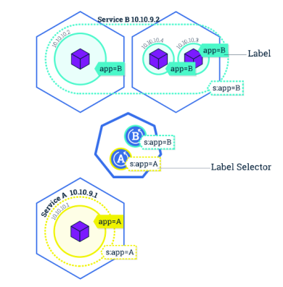
Kubernetes: Label
Key/Value pairs that can be attached to objects to enable a variety of use cases.
Designate objects for specific environments such as development, test and production
Set versions to objects
Set roles or other arbitrary information to classify objects
Can be added or modified at any time
Agile Brains Consulting
44
©Agile Brains Consulting Inc. All rights reserved. Not to be reproduced without prior written consent.
Notes:
-- Add Selectors and Field Selectors, options too for some sample commands like this

Slide 45
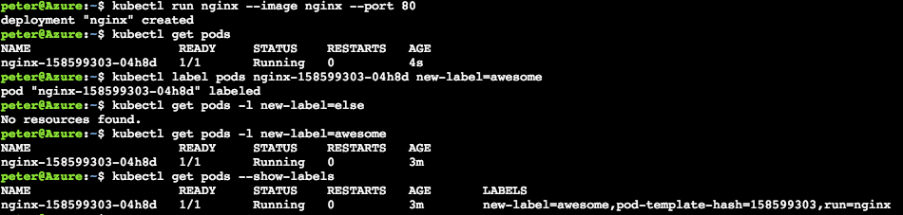
$ kubectl get pod –l name=<label>
Note: Best mechanism to organize Kubernetes objects
labels can be used to provide logical structure
divide by teams, or by environments, or versions
annotations and labels have very subtle difference
$ kubectl create -f helloworld-pod-with-labels.yml
$ kubectl get po --show-labels
Agile Brains Consulting
45
©Agile Brains Consulting Inc. All rights reserved. Not to be reproduced without prior written consent.
Notes:
kubectl run nginx --image nginx --port 80
kubectl get pods
kubectl label pods nginx-158599303-04h8d new-label=awesome
kubectl get pods -l new-label=else
kubectl get pods -l new-label=awesome
kubectl get pods --show-labels
http://kubernetesbyexample.com/labels/

Slide 46
Lab (Kubernetes Labels)
Create a series of pods with different labels
Query the pods based on various labels
Delete pods based on certain selectors
We have already pulled the git repo
Now cd to ex3
https://github.com/shekhar2010us/kubernetes_teach_git/blob/master/ex3/label_usage.md
Ref:- https://www.linkedin.com/learning/learning-kubernetes/next-steps
Agile Brains Consulting
46
©Agile Brains Consulting Inc. All rights reserved. Not to be reproduced without prior written consent.
Notes:
Create a cluster (or reuse a cluster from earlier exercises) and connect to it
Execute the nginx example
https://github.com/kubernetes/kubernetes/blob/master/examples/simple-nginx.md
Some repetition here is intentional. You should be comfortable creating clusters, establishing a connection, verifying its healthy, and then cleaning up resources. This foundation is essential before moving on to advanced concepts

Slide 47
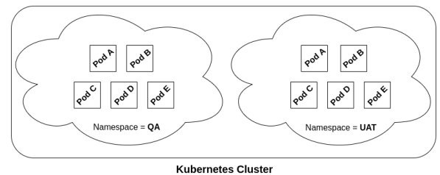
Kubernetes: Namespace
Resources are segmented within namespaces
Sandbox per developer for example
Pods will route dns to default (own) namespace
The same app could run independently in different namespaces
Namespaces create an excellent mechanism to subdivide resources and provide isolation. This enables using a cluster for multiple projects or multiple teams
Agile Brains Consulting
47
©Agile Brains Consulting Inc. All rights reserved. Not to be reproduced without prior written consent.

Slide 48
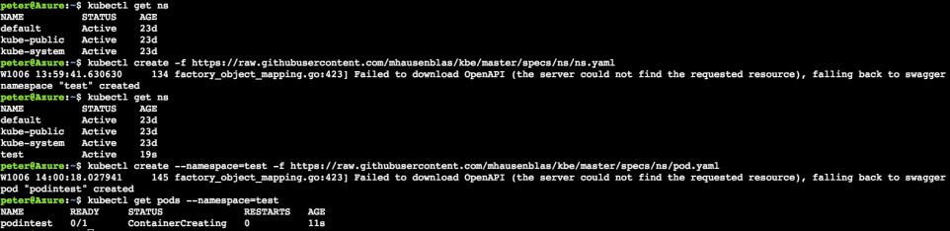
Kubernetes: Namespace
$ kubectl get po,deploy,svc,rs --all-namespaces
$ kubectl create -f <pod_config> -n <namespace_name>
$ kubectl get po -o wide
$ kubectl get po -o wide -n <namespace_name>
$ kubectl delete po simple_pod
$ kubectl delete po simple_pod -n <namespace_name>
Agile Brains Consulting
48
©Agile Brains Consulting Inc. All rights reserved. Not to be reproduced without prior written consent.
Notes:
Get default namespaces
1. kubectl get ns
Create a ‘test’ namespace
2. kubectl create -f https://raw.githubusercontent.com/mhausenblas/kbe/master/specs/ns/ns.yaml
Recheck namespaces and observe
3. kubectl get ns
Now create a pod in this new namespace
4. kubectl create --namespace=test -f https://raw.githubusercontent.com/mhausenblas/kbe/master/specs/ns/pod.yaml
Check pods in this new namespace
5. kubectl get pods --namespace=test
show the resource-quota example and exercise -
https://kubernetes.io/docs/tasks/administer-cluster/manage-resources/quota-memory-cpu-namespace/
also have a namepsace example mini
--

Slide 49
Lab (Namespace)
Create a namespace
check various objects in different namespaces
Can create or delete objects from a specific namespace
cd to ex12
# create two namespaces
kubectl create -f dev-ns.yaml
kubectl create -f prod-ns.yaml
# create two pods with 2 namespaces
kubectl create -f dev-pod.yaml -n dev
kubectl create -f prod-pod.yaml -n prod
# Search for pods
kubectl get pods # show only default ns pods
kubectl get pods -n dev # show dev pods
kubectl get pods -n prod # show prod pods
Agile Brains Consulting
49
©Agile Brains Consulting Inc. All rights reserved. Not to be reproduced without prior written consent.
Notes:
https://github.com/gravitational/workshop/blob/master/k8s101.md
Git clone https://github.com/gravitational/workshop.git
Sections:
Deployments and Replicasets
Services
Back to Deployments
Configuration management basics

Slide 50
Secrets
Agile Brains Consulting
50
©Agile Brains Consulting Inc. All rights reserved. Not to be reproduced without prior written consent.

Slide 51
Kubernetes: Secrets
Kubernetes secret objects let you store and manage sensitive information, such as passwords, OAuth tokens, and ssh keys.
Using secret to store this information is safer and more flexible than putting it verbatim in a container image or Pod Lifecycle definition.
Agile Brains Consulting
51
©Agile Brains Consulting Inc. All rights reserved. Not to be reproduced without prior written consent.

Slide 52
Create Secrets – using “kubectl create secret”
Create files with the content:
Creating secrets from the file:
kubectl create secret generic db-user-pass --from-file=./username.txt --from-file=./password.txt
# Create files needed
echo -n ‘admin’ > ./username.txt
echo -n ‘1f3wr8sdfssf’ > ./password.txt
From file
From literal
kubectl create secret generic test-secret --from-literal=username='my-app' --from-literal=password='39528$vdg7Jb'
Agile Brains Consulting
52
©Agile Brains Consulting Inc. All rights reserved. Not to be reproduced without prior written consent.

Slide 53
Create Secrets – manually Using YAML
Creating base64 encoded Secrets:
secret.yaml
$ echo -n 'admin’ | base64
YWRtaW4=
$ echo -n '1f2d1e2e67df' | base64
MWYyZDFlMmU2N2Rm
apiVersion: v1
kind: Secret
metadata:
name: mysecret
type: Opaque
data:
username: YWRtaW4=
password: MWYyZDFlMmU2N2Rm
Creating secrets from the YAML file:
kubectl create -f ./secret.yaml
Retrieve values of secrets:
kubectl get secret mysecret -o yaml
Agile Brains Consulting
53
©Agile Brains Consulting Inc. All rights reserved. Not to be reproduced without prior written consent.

Slide 54
ConfigMap
Agile Brains Consulting
54
©Agile Brains Consulting Inc. All rights reserved. Not to be reproduced without prior written consent.

Slide 55
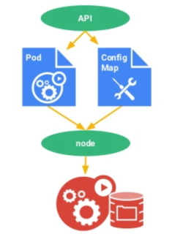
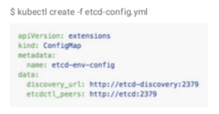
Kubernetes: Configmap
A set of key-value pairs that serve as configuration data for pods. They solve the problem of how to pass config data such as environment variables to pods.
Config maps are commonly composed of:
Command line arguments
Environment variables
Files in a volume
Config maps function similar to secrets, but values are stored as strings and are more readily readable.
Agile Brains Consulting
55
©Agile Brains Consulting Inc. All rights reserved. Not to be reproduced without prior written consent.
Notes:
http://pwittrock.github.io/docs/user-guide/configmap/
Extra resources:
https://docs.openshift.org/latest/dev_guide/configmaps.html

Slide 56
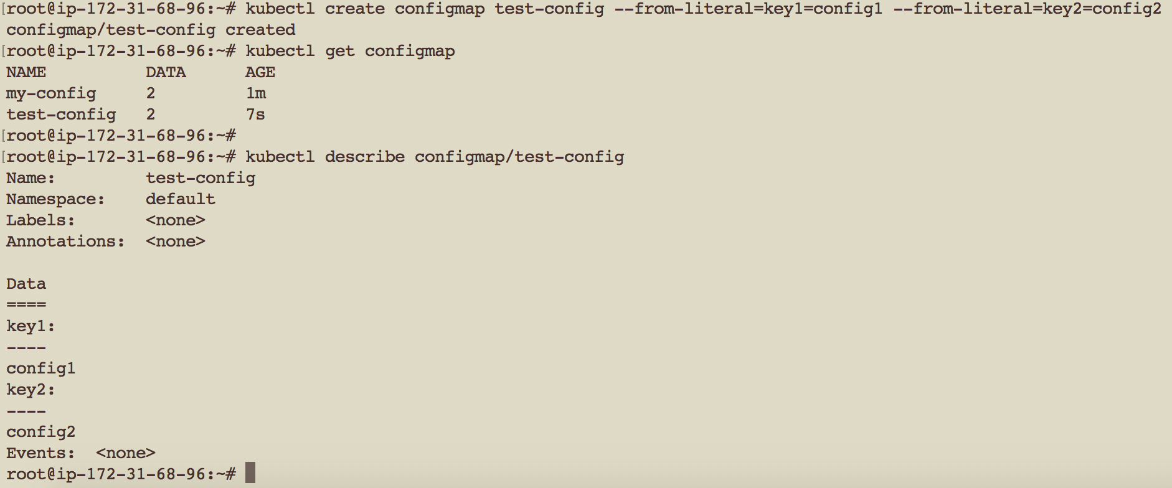
Kubernetes: Config Map
Agile Brains Consulting
56
©Agile Brains Consulting Inc. All rights reserved. Not to be reproduced without prior written consent.
Notes:
http://pwittrock.github.io/docs/user-guide/configmap/
Extra resources:
https://docs.openshift.org/latest/dev_guide/configmaps.html

Slide 57
Kubernetes: Config Map
apiVersion: v1
kind: Pod
metadata:
name: pod-with-cm
spec:
containers:
- name: test-container
image: k8s.gcr.io/busybox
command: [ "/bin/sh", "-c", "env" ]
env:
- name: SPECIAL_LEVEL_KEY
valueFrom:
configMapKeyRef:
name: test-cm
key: key1
restartPolicy: Never
apiVersion: v1
kind: ConfigMap
metadata:
name: test-cm
labels:
name: test-cm
data:
key1: value1
key2: value2
Agile Brains Consulting
57
©Agile Brains Consulting Inc. All rights reserved. Not to be reproduced without prior written consent.
Notes:
http://pwittrock.github.io/docs/user-guide/configmap/
Extra resources:
https://docs.openshift.org/latest/dev_guide/configmaps.html

Slide 58
Lab (Config Maps)
Create a deployment which uses hard coded value for log-level
Create a Config Map
Use the Config map inside a deployment
cd to ex14
https://github.com/shekhar2010us/kubernetes_teach_git/blob/master/ex14/configmap.md
Agile Brains Consulting
58
©Agile Brains Consulting Inc. All rights reserved. Not to be reproduced without prior written consent.
Notes:
https://github.com/gravitational/workshop/blob/master/k8s101.md
Git clone https://github.com/gravitational/workshop.git
Sections:
Deployments and Replicasets
Services
Back to Deployments
Configuration management basics

Slide 59
Daemonset
Agile Brains Consulting
59
©Agile Brains Consulting Inc. All rights reserved. Not to be reproduced without prior written consent.

Slide 60
Kubernetes: DaemonSet
A DaemonSet ensures that all (or some) Nodes run a copy of a Pod. As nodes are added to the cluster, Pods are added to them. As nodes are removed from the cluster, those Pods are garbage collected. Deleting a DaemonSet will clean up the Pods it created.
- Usually used for pods meant for Monitoring or collecting logs
Agile Brains Consulting
60
©Agile Brains Consulting Inc. All rights reserved. Not to be reproduced without prior written consent.

Slide 61
Kubernetes: DaemonSet .spec Section
DaemonSet need a .spec section
Fields for DaemonSet .spec section:
Pod Template (.spec.template) – to specify the template for the pod creation
Pod Selector (.spec.selector) – used for selecting Pods
Pod Selector Fields:
matchLabels
matchExpressions
Agile Brains Consulting
61
©Agile Brains Consulting Inc. All rights reserved. Not to be reproduced without prior written consent.

Slide 62
Cronjob
Agile Brains Consulting
62
©Agile Brains Consulting Inc. All rights reserved. Not to be reproduced without prior written consent.

Slide 63
Kubernetes: Jobs and Cron Jobs
Jobs - Creates one or more pods and ensures that a specified number of them successfully terminate. As pods successfully complete, the job tracks the successful completions. When a specified number of successful completions is reached, the job itself is complete. Deleting a Job will cleanup the pods it created, and is run one-time
Cron Job - A Cron Job creates Jobs on a time-based schedule. One Cron Job object is like one line of a crontab (cron table) file. It runs a job periodically on a given schedule
Agile Brains Consulting
63
©Agile Brains Consulting Inc. All rights reserved. Not to be reproduced without prior written consent.
Notes:
https://kubernetes.io/docs/concepts/workloads/controllers/statefulset/

Slide 64
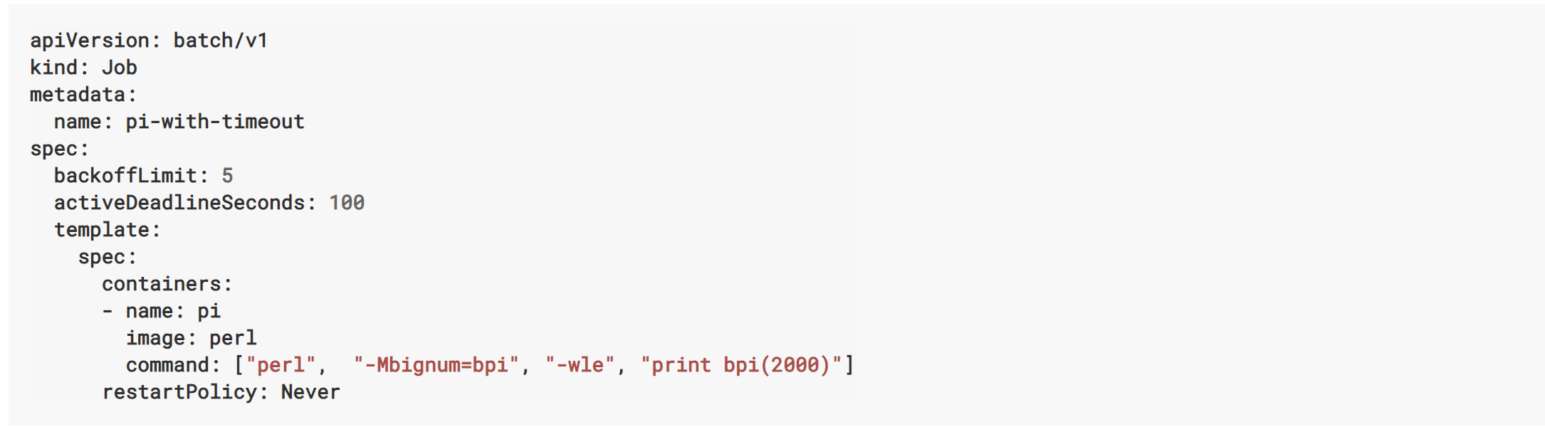
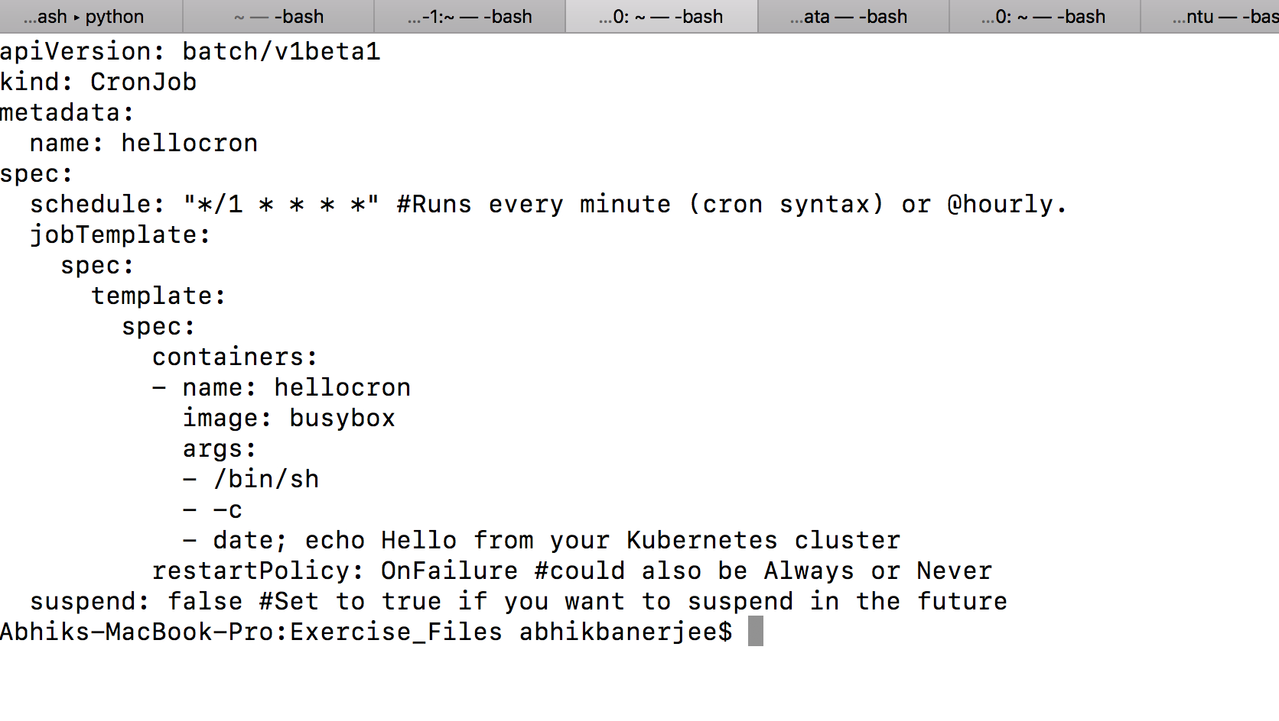
Kubernetes: Jobs and Cron Jobs
Agile Brains Consulting
64
©Agile Brains Consulting Inc. All rights reserved. Not to be reproduced without prior written consent.
Notes:
https://kubernetes.io/docs/concepts/workloads/controllers/statefulset/

Slide 65
Lab (Jobs and Cron Jobs)
Create Job and check the logs
Create a Cron Job,
Edit the Cron Job
cd to ex9
https://github.com/shekhar2010us/kubernetes_teach_git/blob/master/ex9/cronjob.md
Agile Brains Consulting
65
©Agile Brains Consulting Inc. All rights reserved. Not to be reproduced without prior written consent.
Notes:
https://github.com/gravitational/workshop/blob/master/k8s101.md
Git clone https://github.com/gravitational/workshop.git
Sections:
Deployments and Replicasets
Services
Back to Deployments
Configuration management basics

Slide 66
Stateful and Stateless sets
Agile Brains Consulting
66
©Agile Brains Consulting Inc. All rights reserved. Not to be reproduced without prior written consent.

Slide 67
Kubernetes: StatefulSets
StatefulSet is the workload API object used to manage stateful applications.
It manages the deployment and scaling of a set of Pods, and provides guarantees about the ordering and uniqueness of these Pods.
Like a Deployment, a StatefulSet manages Pods that are based on an identical container spec.
Unlike a Deployment, a StatefulSet maintains a sticky identity for each of their Pods. These pods are created from the same spec, but are not interchangeable: each has a persistent identifier that it maintains across any rescheduling.
Agile Brains Consulting
67
©Agile Brains Consulting Inc. All rights reserved. Not to be reproduced without prior written consent.

Slide 68
How to assign pods to nodes
Agile Brains Consulting
68
©Agile Brains Consulting Inc. All rights reserved. Not to be reproduced without prior written consent.

Slide 69
Kubernetes: Assigning Pods to Nodes
You can constrain a pod to only be able to run on particular nodes or to prefer to run on particular nodes. There are several ways to do this, and the recommended approaches all use label selectors to make the selection.
nodeSelector is the simplest recommended form of node selection constraint.
nodeSelector is a field of PodSpec. It specifies a map of key-value pairs. For the pod to be eligible to run on a node, the node must have each of the indicated key-value pairs as labels (it can have additional labels as well). The most common usage is one key-value pair.
Agile Brains Consulting
69
©Agile Brains Consulting Inc. All rights reserved. Not to be reproduced without prior written consent.

Slide 70
Kubernetes: nodeSelector Example
Step1: Label the nodes
kubectl label nodes <node-name> <label-key>=<label-value>
Eg:- kubectl label nodes kubernetes-foo-node-1.c.a-test.internal disktype=ssd
pod-nginx.yaml
apiVersion: v1
kind: Pod
metadata:
name: nginx
labels:
env: test
spec:
containers:
- name: nginx
image: nginx
imagePullPolicy: IfNotPresent
nodeSelector:
disktype: ssd
Step2: Assign the Pod creation on node with label ‘disktype’ and value ‘ssd’
kubectl create -f pod-nginx.yaml
Agile Brains Consulting
70
©Agile Brains Consulting Inc. All rights reserved. Not to be reproduced without prior written consent.

Slide 71
Pod Priority
Agile Brains Consulting
71
©Agile Brains Consulting Inc. All rights reserved. Not to be reproduced without prior written consent.

Slide 72
Kubernetes: Pod Priority
Pods can have priority. Priority indicates the importance of a Pod relative to other Pods. If a Pod cannot be scheduled, the scheduler tries to pre-empt (evict) lower priority Pods to make scheduling of the pending Pod possible.
Agile Brains Consulting
72
©Agile Brains Consulting Inc. All rights reserved. Not to be reproduced without prior written consent.
Notes:
-- can have any priority between 1 to 1 billion - 10^9, because 1 billion 1 is assigned to kube-system resources

Slide 73
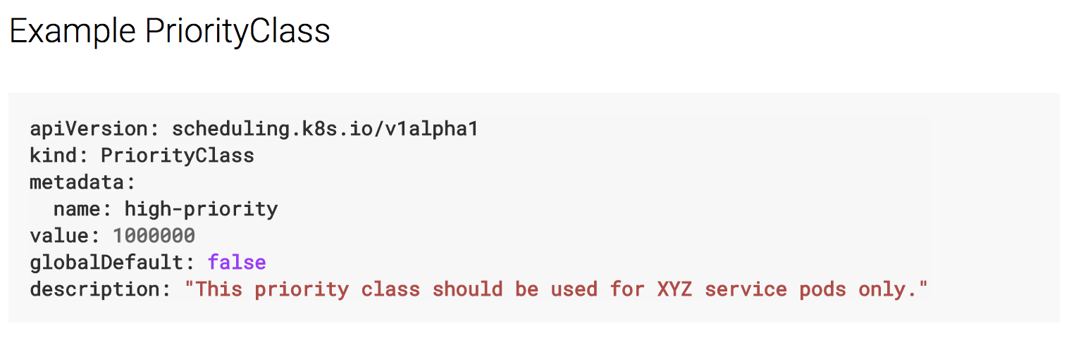
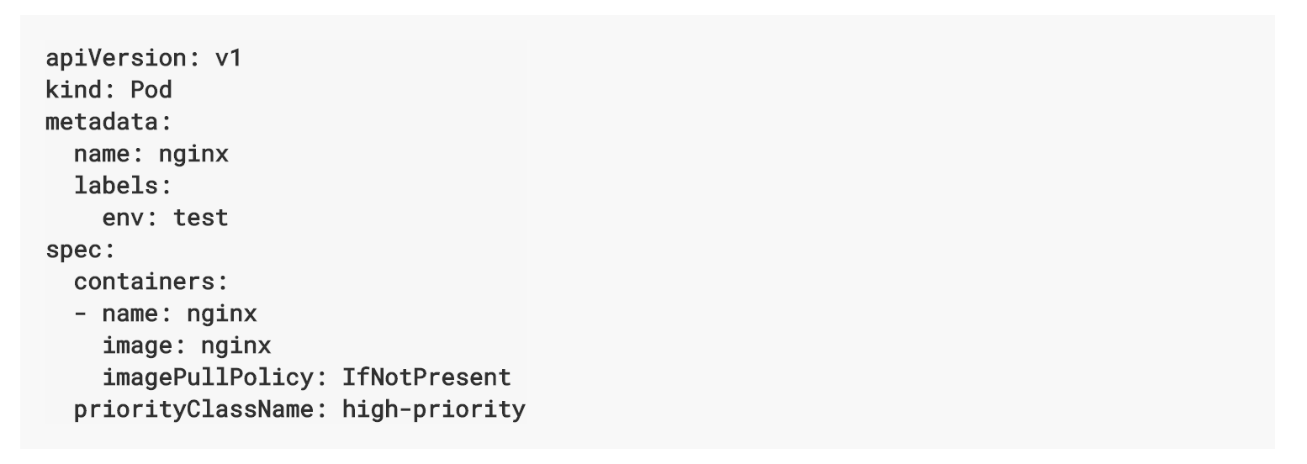
Kubernetes: Pod Priority
Set the priority for pod scheduling but cannot ask never to kill a pod
Agile Brains Consulting
73
©Agile Brains Consulting Inc. All rights reserved. Not to be reproduced without prior written consent.
Notes:
-- can have any priority between 1 to 1 billion - 10^9, because 1 billion 1 is assigned to kube-system resources

Slide 74
Pod Pre-emption
Agile Brains Consulting
74
©Agile Brains Consulting Inc. All rights reserved. Not to be reproduced without prior written consent.

Slide 75
Kubernetes: Pod Pre-emption
When Pods are created, they go to a queue and wait to be scheduled. The scheduler picks a Pod from the queue and tries to schedule it on a Node. If no Node is found that satisfies all the specified requirements of the Pod, pre-emption logic is triggered for the pending Pod.
The disablePreemption flag is set to false by default.
Agile Brains Consulting
75
©Agile Brains Consulting Inc. All rights reserved. Not to be reproduced without prior written consent.
Notes:
-- can have any priority between 1 to 1 billion - 10^9, because 1 billion 1 is assigned to kube-system resources

Slide 76
Kubernetes: Disabling Preemption
Option available in component configs only.
Configuration file
apiVersion: componentconfig/v1alpha1
kind: KubeSchedulerConfiguration
algorithmSource:
provider: DefaultProvider
...
disablePreemption: true
Agile Brains Consulting
76
©Agile Brains Consulting Inc. All rights reserved. Not to be reproduced without prior written consent.
Notes:
-- can have any priority between 1 to 1 billion - 10^9, because 1 billion 1 is assigned to kube-system resources

Slide 77
Node taints and node roles
Agile Brains Consulting
77
©Agile Brains Consulting Inc. All rights reserved. Not to be reproduced without prior written consent.

Slide 78
Kubernetes: Node taints
Node affinity is a property of pods that attracts them to a set of nodes (either as a preference or a hard requirement). Taints are the opposite – they allow a node to repel a set of pods.
Taints and tolerations work together to ensure that pods are not scheduled onto inappropriate nodes. One or more taints are applied to a node; this marks that the node should not accept any pods that do not tolerate the taints.
Agile Brains Consulting
78
©Agile Brains Consulting Inc. All rights reserved. Not to be reproduced without prior written consent.
Notes:
-- can have any priority between 1 to 1 billion - 10^9, because 1 billion 1 is assigned to kube-system resources

Slide 79
Adding and removing a taint to node
Tainting a node named ‘node1’
kubectl taint nodes node1 key=value:NoSchedule
Taint effect NoSchedule means no Pod will be able to schedule onto node1.
Removing taint of the node ‘node1’
kubectl taint nodes node1 key=value:NoSchedule-
Agile Brains Consulting
79
©Agile Brains Consulting Inc. All rights reserved. Not to be reproduced without prior written consent.
Notes:
-- can have any priority between 1 to 1 billion - 10^9, because 1 billion 1 is assigned to kube-system resources

Slide 80
Kubernetes: Node role
A node role is just a label with the format:
node-role.kubernetes.io/<role>
It can be added using kubectl label command.
Adding a role to node
kubectl label test.node.test.com node-role.kubernetes.io/worker
Removing a role from node
kubectl label test.node.test.com node-role.kubernetes.io/worker-
Agile Brains Consulting
80
©Agile Brains Consulting Inc. All rights reserved. Not to be reproduced without prior written consent.
Notes:
-- can have any priority between 1 to 1 billion - 10^9, because 1 billion 1 is assigned to kube-system resources

Slide 81
Resource quotas
Agile Brains Consulting
81
©Agile Brains Consulting Inc. All rights reserved. Not to be reproduced without prior written consent.

Slide 82
Kubernetes: Resource Quotas
When several users or teams share a cluster with a fixed number of nodes, there is a concern that one team could use more than its fair share of resources.
Resource quotas are a tool for administrators to address this concern.
It is defined by “ResourceQuota” object. It provides constraints that limit aggregate resource consumption per namespace.
Agile Brains Consulting
82
©Agile Brains Consulting Inc. All rights reserved. Not to be reproduced without prior written consent.
Notes:
-- can have any priority between 1 to 1 billion - 10^9, because 1 billion 1 is assigned to kube-system resources

Slide 83
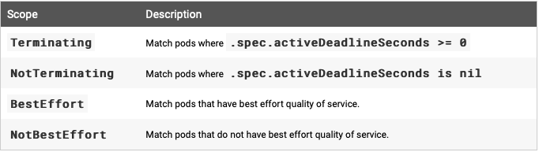
Kubernetes: Resource Quotas - Scopes
Each quota can have an associated set of scopes. A quota will only measure usage for a resource if it matches the intersection of enumerated scopes.
Agile Brains Consulting
83
©Agile Brains Consulting Inc. All rights reserved. Not to be reproduced without prior written consent.
Notes:
-- can have any priority between 1 to 1 billion - 10^9, because 1 billion 1 is assigned to kube-system resources

Slide 84
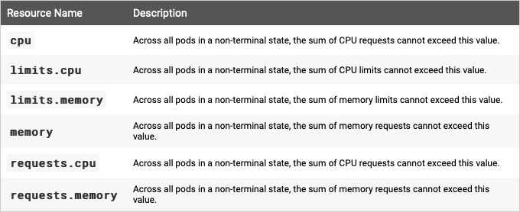
Kubernetes: Compute Resource Quotas
Agile Brains Consulting
84
©Agile Brains Consulting Inc. All rights reserved. Not to be reproduced without prior written consent.
Notes:
-- can have any priority between 1 to 1 billion - 10^9, because 1 billion 1 is assigned to kube-system resources

Slide 85
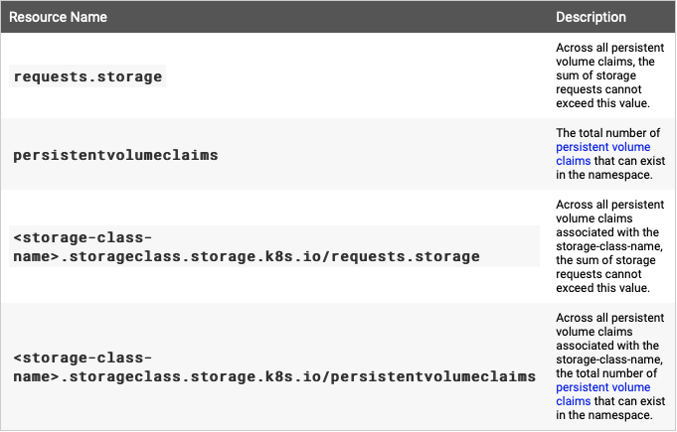
Kubernetes: Storage Resource Quotas
Agile Brains Consulting
85
©Agile Brains Consulting Inc. All rights reserved. Not to be reproduced without prior written consent.
Notes:
-- can have any priority between 1 to 1 billion - 10^9, because 1 billion 1 is assigned to kube-system resources

Slide 86
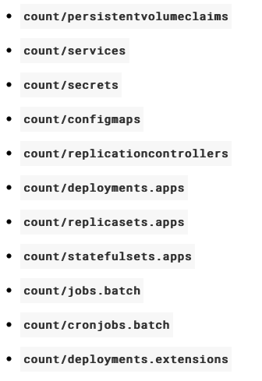
Kubernetes: Object Count Quotas
Agile Brains Consulting
86
©Agile Brains Consulting Inc. All rights reserved. Not to be reproduced without prior written consent.
Notes:
-- can have any priority between 1 to 1 billion - 10^9, because 1 billion 1 is assigned to kube-system resources

Slide 87
Kubernetes: Resource Quotas Example
quota.yml
apiVersion: v1
kind: List
items:
- apiVersion: v1
kind: ResourceQuota
metadata:
name: pods-medium
spec:
hard:
cpu: "10"
memory: 20Gi
pods: "10"
scopeSelector:
matchExpressions:
- operator : In
scopeName: PriorityClass
values: ["medium"]
Agile Brains Consulting
87
©Agile Brains Consulting Inc. All rights reserved. Not to be reproduced without prior written consent.
Notes:
-- can have any priority between 1 to 1 billion - 10^9, because 1 billion 1 is assigned to kube-system resources

